Slide 1
Week 6 Presentation
RunTime Terror

Slide 2
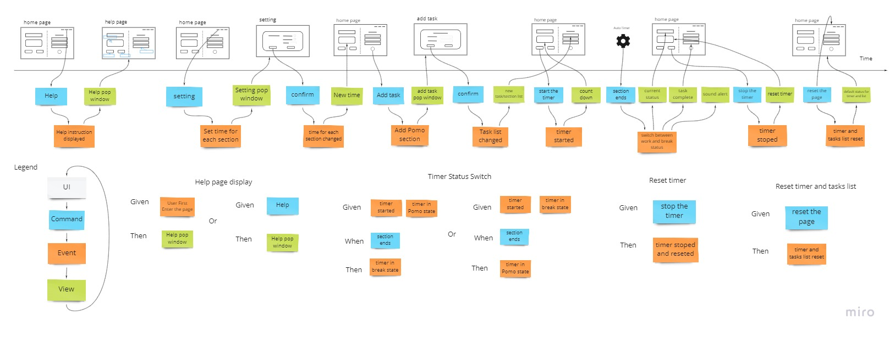
Pitch
Created our pitch
Our system diagram:

Slide 3
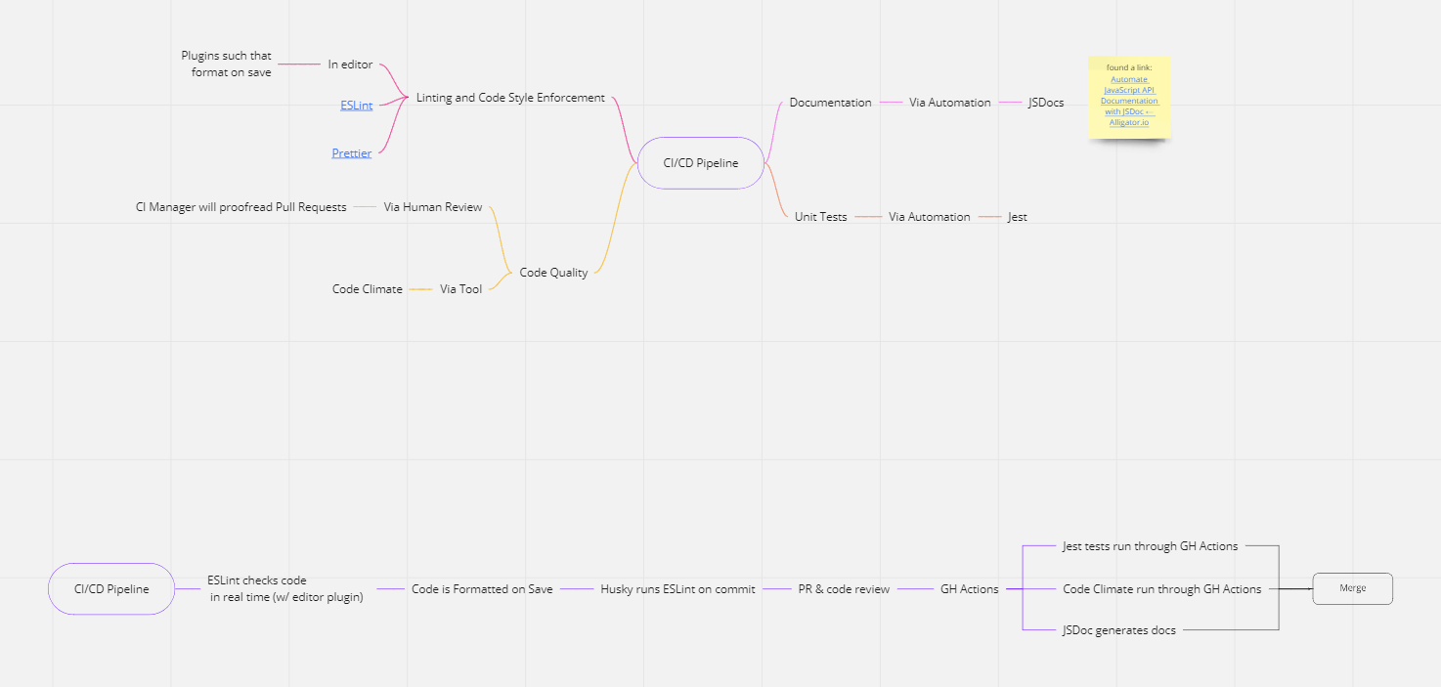
Pipeline Brainstorm and Creation

Slide 4
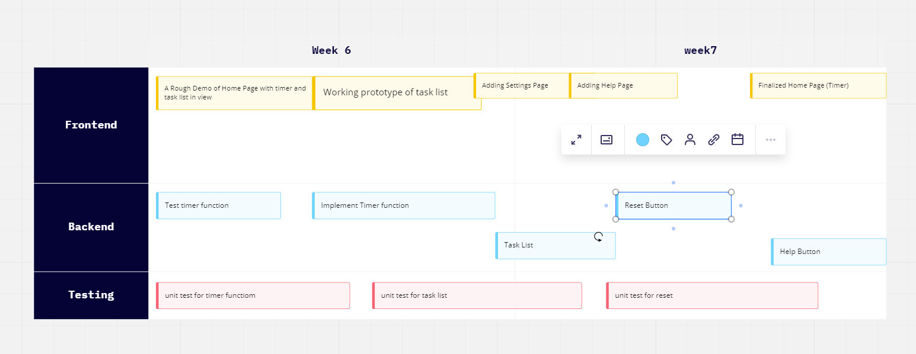
2 Week plan

Slide 5
New Repository
Changed to privately owned repository
Includes Wiki page

